Slide 1

By Rishabh Chaudhary
Business Analyst Career Program - Capstone Project

Slide 2

Agenda
Data Exploration
Statistical Analysis using Excel
Graphical Analysis using Excel
Successful Importing of Data and Basic SQL Queries in SQL Workbench
Unlocking Insights: Mastering the Import of SQL Database Data into Power BI
Power BI Dashboard and Analysis: Unleashing Data Insights for Powerful Presentations
Comprehensive Analysis Report: Decoding Key Trends and Patterns
Key Findings and Implications: Unveiling the Conclusion & Inferences
Actionable Insights: Transforming Findings into Effective Strategies
Endnotes

Slide 3
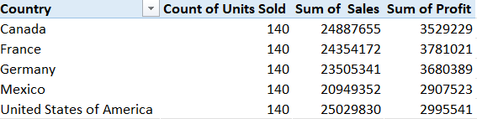
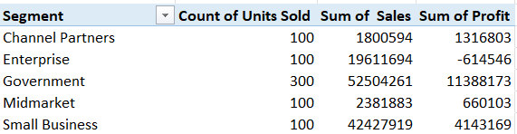
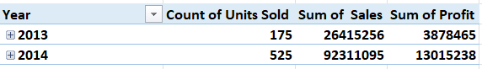
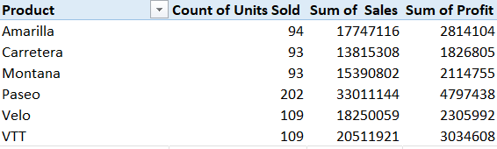
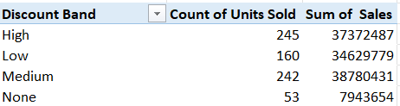
Data Exploration
Country Wise Sales & Profit Segment Wise Sales & Profit
Year Wise Sales & Profit
Product Wise Sales & Profit
Discount Band Wise Units Sold & Sales

Slide 4
Statistical Analysis using Excel
"Exploring the Numbers: Descriptive Statistics for Units Sold across Countries using Excel“
Summary
Mean | 1608
Standard Error | 33
Median | 1543
Mode | 727
Standard Deviation | 867
Sample Variance | 752431
Kurtosis | 0
Skewness | 0
Range | 4293
Minimum | 200
Maximum | 4493
Sum | 1125806
Count | 700
Frequency Table
Upper bin | Frequency
500 | 69
1000 | 132
1500 | 136
2000 | 130
2500 | 113
3000 | 96
3500 | 7
More | 17
Units Sold | lower bin | upper bin
0 to 500 | 0 | 500
500 to 1000 | 500 | 1000
1000 to 1500 | 1000 | 1500
1500 to 2000 | 1500 | 2000
2000 to 2500 | 2000 | 2500
2500 to 3000 | 2500 | 3000
3000 to 4000 | 3000 | 3500
4000 and more | 4000
Percentiles
P10 | 10% | 520
P25 | 25% | 905
P50 | 50% | 1543
P75 | 75% | 2229
P90 | 90% | 2761
P99 | 99% | 3875

Slide 5
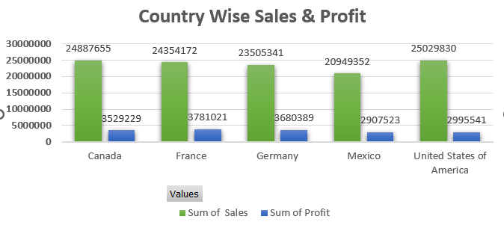
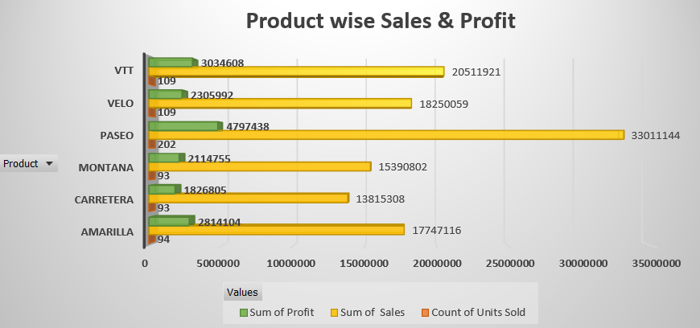
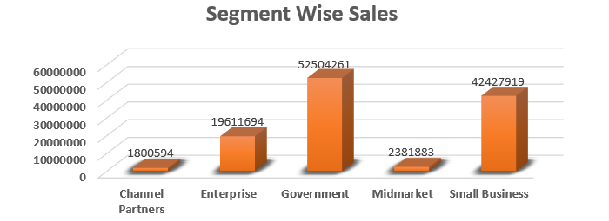
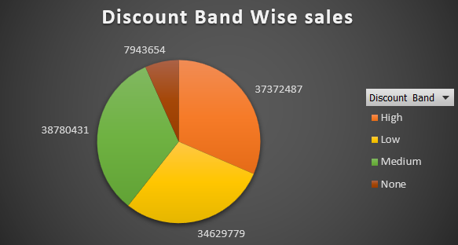
Graphical Analysis using Excel
"Visualizing Insights: Harnessing the Power of Excel for Graphical Analysis"

Slide 6
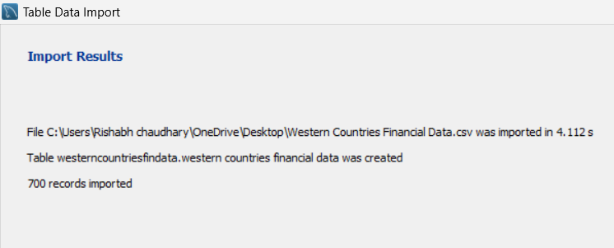
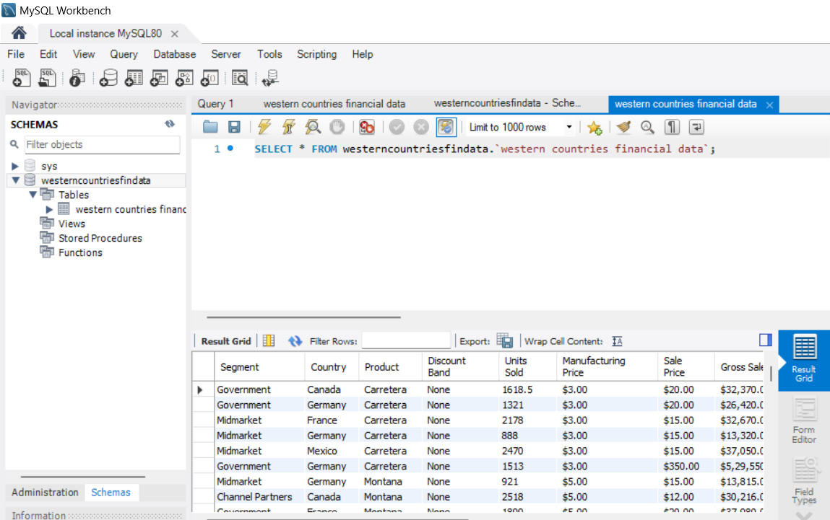
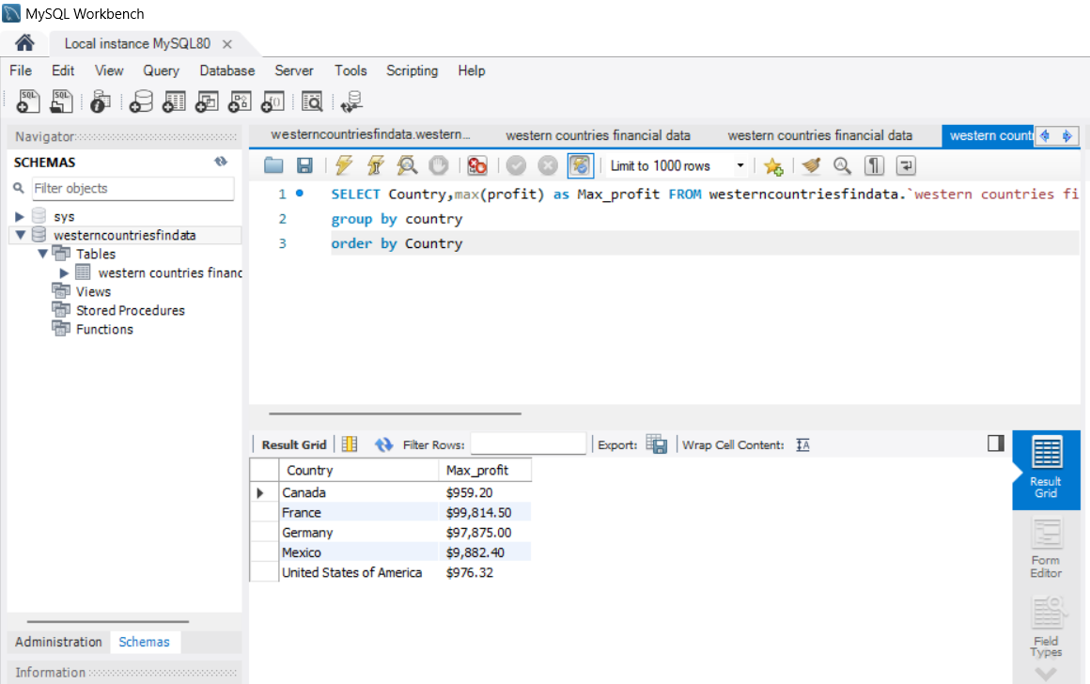
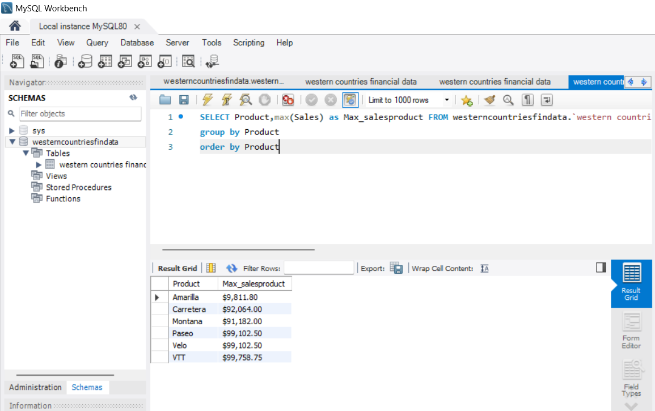
Successful Importing of Data and Basic SQL Queries in SQL Workbench
Our successful import of data into SQL Workbench database and execution of basic SQL queries have empowered us to analyze and manipulate data effectively. By utilizing the various SQL clauses and functions, we were able to retrieve specific data, apply filtering, sorting, aggregation, and grouping, thus gaining valuable insights from our database. This accomplishment enables us to further explore the data and make informed decisions based on our analysis.

Slide 7
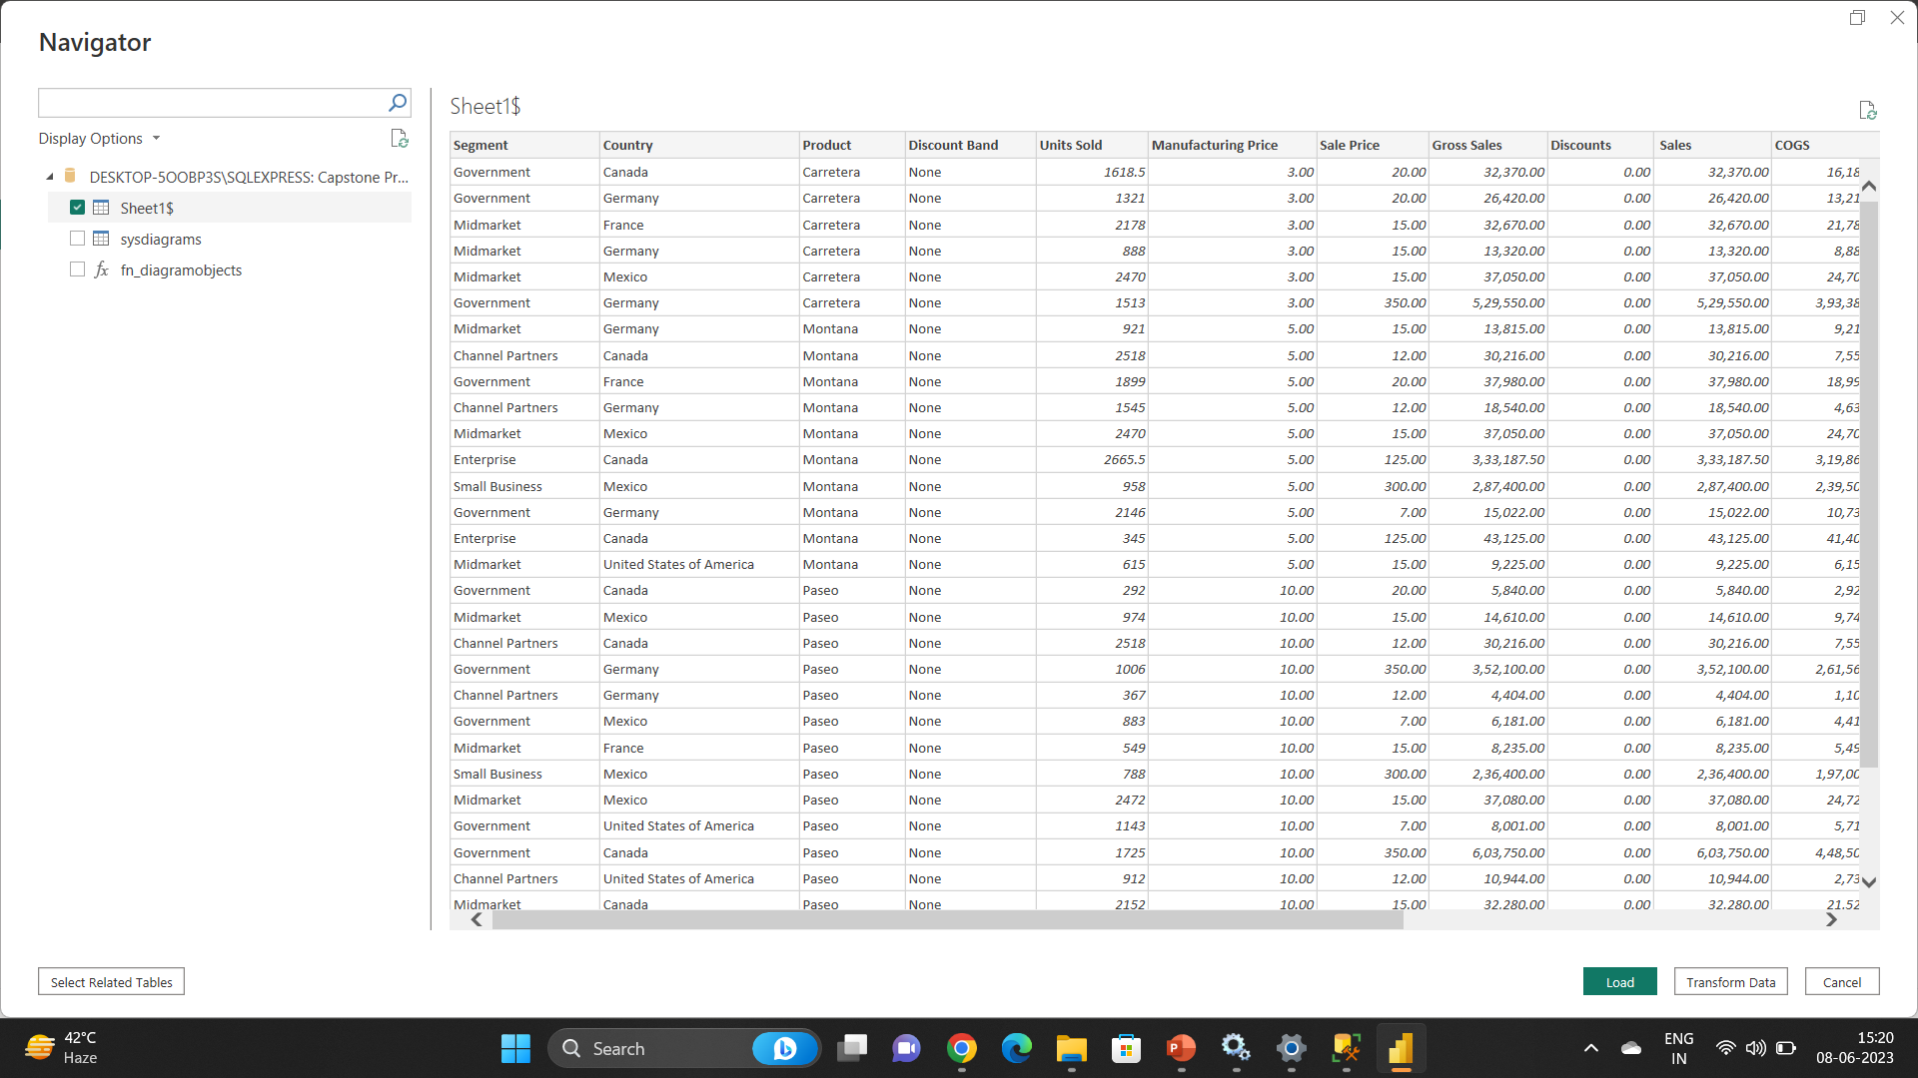
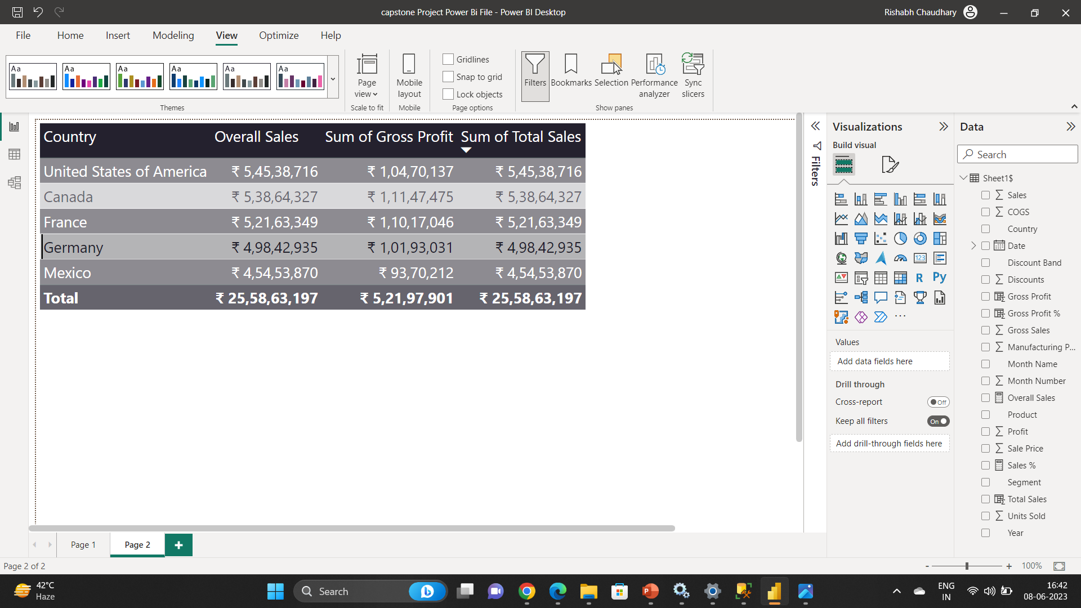
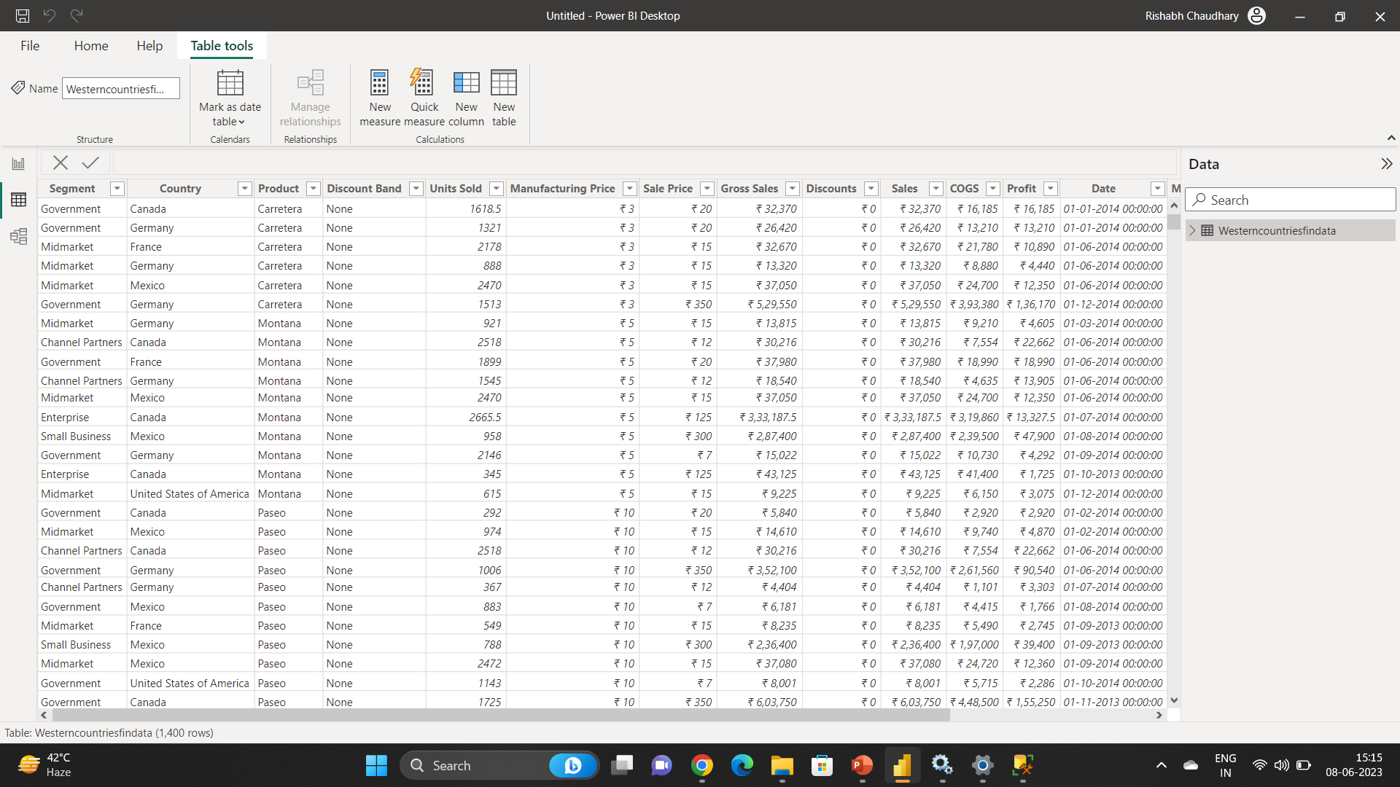
Unlocking Insights: Mastering the Import of SQL Database Data into Power BI
Importing data from a SQL database to Power BI involves establishing a connection, selecting tables/views, applying transformations, optimizing performance, scheduling refresh, ensuring data security, validating the data, and publishing the reports. This process enables users to leverage Power BI's capabilities for data visualization and analysis, enhancing decision-making.

Slide 8
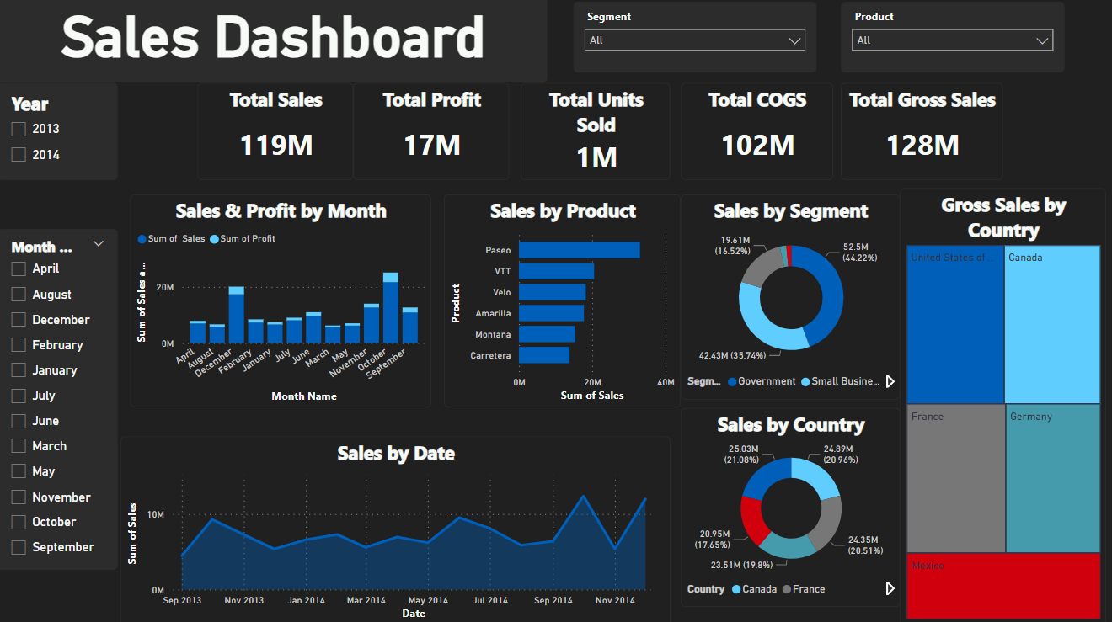
Power BI Dashboard and Analysis: Unleashing Data Insights for Powerful Presentations
A Power BI dashboard is an invaluable tool for analyzing and visualizing financial sales data. By utilizing Power BI's capabilities, businesses can gain valuable insights into their sales performance, identify trends, and make data-driven decisions to drive growth and profitability

Slide 9
Comprehensive Analysis Report: Decoding Key Trends and Patterns
The analysis of the profit data reveals interesting insights about different countries and channels. Among the countries, Canada emerges as the most profitable market, generating a total profit of $3,529,228.89. France and Germany follow closely with profits of $3,781,020.78 and $3,680,388.82, respectively. Mexico and the United States of America had relatively lower profits, with $2,907,523.11 and $2,995,540.67, respectively.
When considering profitability by channel, the Government channel stands out as the most lucrative, accounting for a significant profit of $11,388,173.17. The Small Business channel also performs well, generating a profit of $4,143,168.50. However, the Enterprise and Midmarket channels experienced losses, with profits of -$614,545.63 and $660,103.08, respectively. The Channel Partners channel achieved moderate success with a profit of $1,316,803.14.
Examining the sales and cost of goods sold (COGS) data by country, it becomes evident that the United States of America takes the lead in sales with a substantial figure of $25,029,830.17. Canada follows closely behind with $24,887,654.89 in sales. In terms of COGS, the United States of America also tops the list, incurring costs of $22,034,289.50. France and Germany show respectable sales and COGS figures, while Mexico reports relatively lower numbers.
Analyzing the COGS and discounts by country, it is notable that the United States of America again has the highest COGS at $22,034,289.50, followed by Canada at $21,358,426. France and Germany exhibit lower COGS figures, while Mexico reports the lowest COGS. The United States of America also leads in discounts, with a total of $2,239,527.84. France and Germany rank second and third in terms of discounts offered.
In summary, Canada, France, and Germany emerge as profitable markets, while the United States of America dominates in sales, COGS, and discounts. The Government and Small Business channels prove to be lucrative, while the Enterprise and Midmarket channels face challenges in generating profits. These insights provide a starting point for further analysis and strategic decision-making within the business.

Slide 10
Key Findings and Implications: Unveiling the Conclusion & Inferences
Conclusion
Canada emerged as the most profitable market, followed closely by France and Germany.
The Government channel generated the highest profit, while the Enterprise and Midmarket channels faced challenges.
The United States of America dominated in sales, cost of goods sold (COGS), and discounts.
Inferences
1- Market Analysis:
Canada, France, and Germany are key markets for profitability and should be further explored for business growth.
Targeting the Government and Small Business sectors can lead to higher profits.
.

Slide 11
Key Findings and Implications: Unveiling the Conclusion & Inferences
2- Channel Strategy:
Focus on strengthening the Channel Partners channel to increase profitability.
Evaluate the performance of the Enterprise and Midmarket channels and consider strategies for improvement or realignment
3- Sales and COGS:
The United States of America represents a significant sales opportunity, but managing COGS is crucial to maximize profitability.
Analyse the factors contributing to the high COGS in the United States and explore cost optimization measures.
4- Discounts and Customer Engagement:
The United States of America's willingness to offer discounts presents an opportunity to attract customers.
Develop targeted marketing and engagement strategies to capitalize on discount-oriented markets.

Slide 12
Actionable Insights: Transforming Findings into Effective Strategies
Focus on expanding operations and marketing efforts in Canada, France, and Germany.
Allocate resources to optimize performance in the Government and Small Business channels.
Conduct a thorough review of the Enterprise and Midmarket channels to identify areas for improvement.
Implement cost optimization strategies to manage COGS, particularly in the United States.
Develop customer engagement campaigns that leverage discounts and sales promotions in target markets.

Slide 13
Endnotes
Reference Links:-
Western Countries Financial Data Excel File.xlsx
capstone Project Power Bi File.pbix
Project Overview: This business analysis project aimed to identify and assess the current state of a specific business or organization, analyze its processes, and propose recommendations for improvement.
Objectives: The project objectives were to understand the business's goals and challenges, identify areas of improvement, gather requirements for potential solutions, and provide actionable insights to enhance business performance.
Conclusion: This business analysis project provided valuable insights into the current state of the business, identified areas for improvement, and proposed actionable recommendations. By leveraging data-driven analysis and engaging stakeholders effectively, the project contributed to the organization's growth and success.

